Slide 1
Hello Everyone Course Code : CSE201 Course Title : Data Structure
Course Teacher:
Md. Jamal Uddin
Assistant Professor
Department of CSE,BSMRSTU,
Gopalganj-8100.
Presented By:
Tushar Sarkar
Student ID: 18CSE035
Department of CSE,BSMRSTU,
Gopalganj-8100.

Slide 2
Queue

Slide 3
Outline
What is Queue?
Queue Operations
Illustration/Example
Storing a Queue in Static Data
Storing a Queue in Dynamic data
Pseudo Code
Complexity
Advantages & Disadvantages
Conclusion

Slide 4

What is Queue?
A Queue is a linear data structure. The concept is quite similar with stack.
Additions are made at the end or tail of the queue while removals are made from the front or head of the queue.
Access system a queue is referred to FIFO(First-In First-Out) and LILO(Last-in Last-Out) structure.
Example:

Slide 5
Queue Operations
Add : adds a new node
Add(X,Q)-> add the value X to the tail of queue.
Remove : remove a node
Remove(Q)-> removes the head node and returns its value.
IsEmpty : reports whether the queue is empty
IsEmpty(Q)-> report whether the queue is empty().
IsFull : reports whether the queue is full
IsFull(Q)-> report whether the queue is full.
Initialize : cleats/initializes the queue
Initilize(Q)-> create a new empty queue named Q.
Destroy : deletes the contents of the queue
Destroy(Q)-> delete the contents of the queue Q.

Slide 6
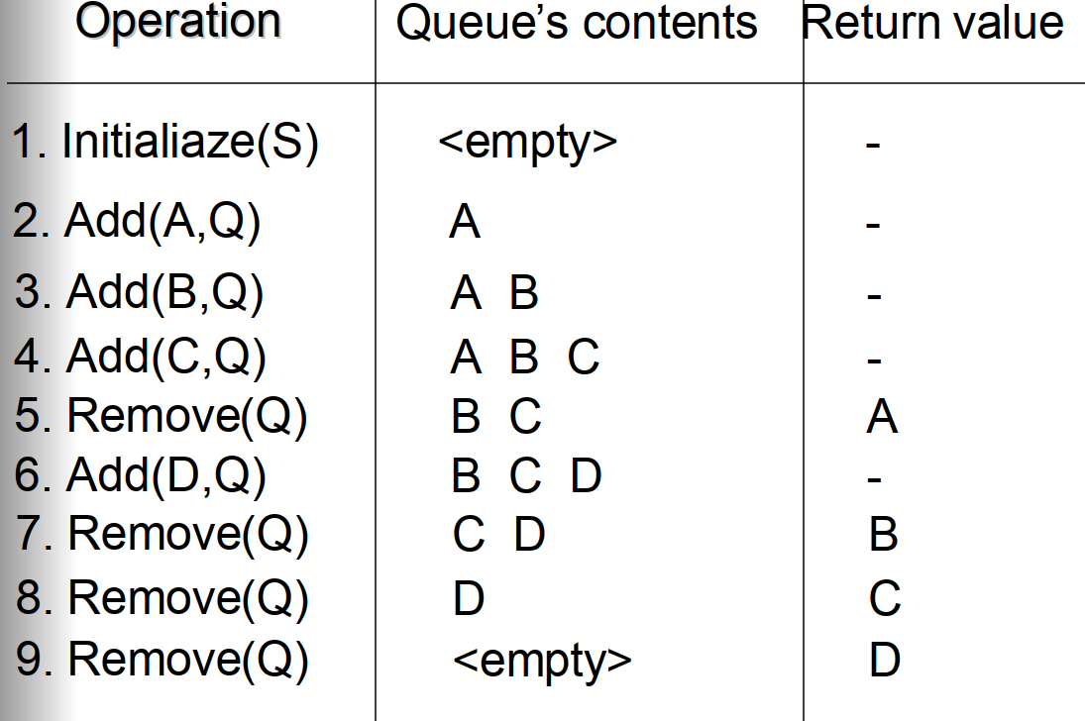
Illustration/Example

Slide 7
Storing a Queue in Static Data
This implementation stores the queue in an array
The array indices at which the head and tail of the queue are currently stored must be maintained.
The head of the queue is not necessarily at index 0.
The array can be “circular array” – the queue “wraps round” if the last index of the array is reached.

Slide 8
Storing a queue in an array of length
Add(A,Q) Head : 0
Tail : 0
Add(D,Q) Head : 0
Tail : 1
Add(Z,Q) Head : 0
Tail : 2
Remove(Q) Head : 1
Tail : 2
Add(X,Q) Head : 1
Tail : 3
A
A | D
A | D | Z
 | D | Z
 | D | Z | X

Slide 9
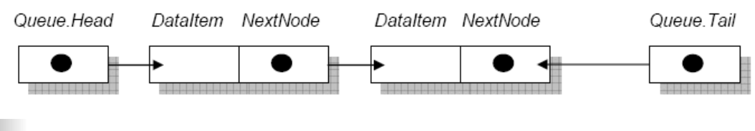
Storing a Queue in Dynamic Data
Each node in a dynamic data structure contains data AND a reference to the next node.
A queue also needs a reference to the head AND a reference to the tail node.
The Following diagram describes the storage of a queue called Queue. Each node consists of data(Dataltem) nd a reference (NextNode)

Slide 10
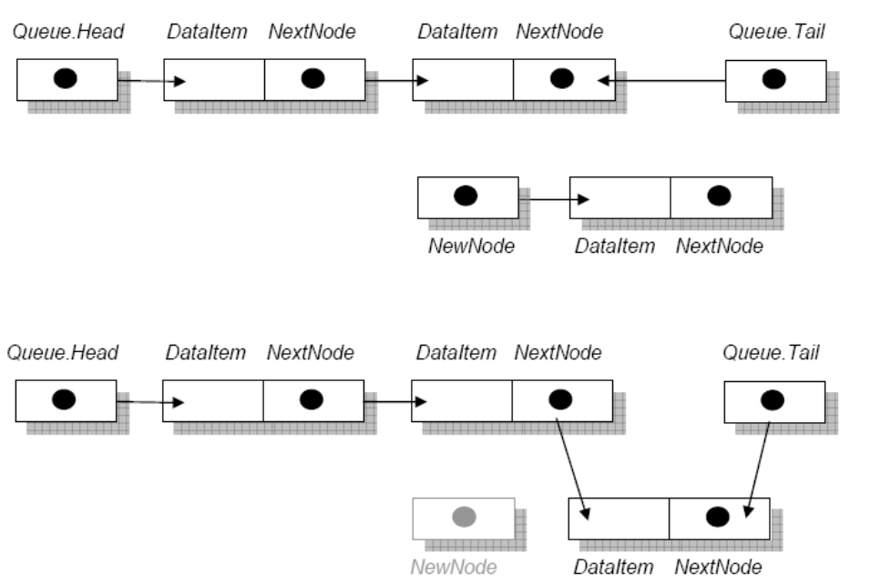
Storing a Queue in Dynamic Data
The new node is to be added at the tail of the queue.
The reference Queue.Tail should point to the new node, and the NextNode reference of the node previously at the tail of the queue should point to the Dataltem of the new node.

Slide 11
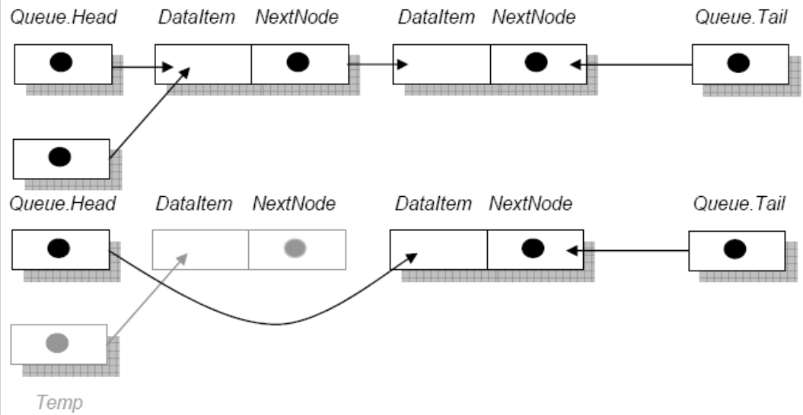
Storing a Queue in Dynamic Data
The value of Queue.Head.Dataltem is returned. A temporary reference Temp is declared and set to point to head node in the queue (Temp=Queue.Head)
Queue.Head is then set to point to the second node instead of the top node.

Slide 12
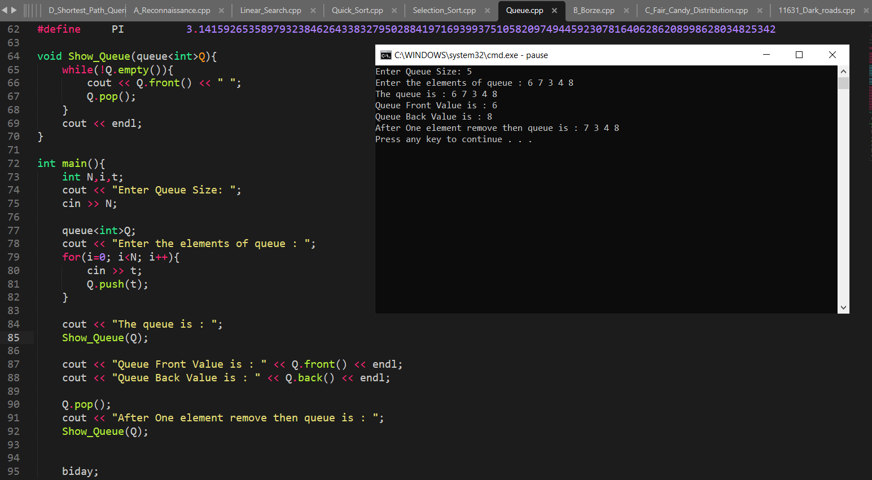
Pseudo Code
.

Slide 13
Complexity
The complexity of enqueuer and dequeuer operations in a queue using array is O(1).
If you use pop(N) in code, then the complexity might be O(n) depending on the position of the item to be popped

Slide 14
Advantages of Queue
The main advantages is that adding or removing elements can be done quickly and efficiently because you would just add elements to the end of the queue or remove them from the front of the queue.
Queues have the advantages of being able to handle multiple data types and they are both flexible and flexibility and fast.
Moreover, queues can be of potentially infinite length compared with the use of fixed-length arrays.

Slide 15
Disadvantages of Queue
The main disadvantages is that a queue is not readily searchable (sure there are hacks around it but it is not supposed to be searchable) and adding or removing elements from the middle of the queue is very complex (again it is not MEANT to allow elements to be removed from the middle).
The queue is not readily searchable.
You have to start from the end and might have to maintain another queue.
So if you have some data, which later on you would want to be searchable, then don't even think about using a queue.
Adding or deleting elements from the middle of the queue is complex as well.

Slide 16
Conclusion
The queue data structure is a linear type of data structure that is used to store the elements. ...
A queue data structure used an array or linked list during its implementation.
Insertion in queue occurs at the REAR end, and deletion from queue occurs at the FRONT end.

Slide 17
Thank You

